Slide 1
USING CONVOLUTIONAL AUTOENCODERS TO IMPROVE IMAGE QUALITY OF GALAXIES
Rohan Gupta

Slide 2
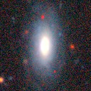
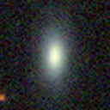
WHAT ARE WE TRYING TO DO?
Given lower quality images captured from Sloan Data Sky Survey (SDSS) and high quality images of Hyper Suprime Camera (HSC) telescope, can we train a machine learning model to denoise and improve low quality images of galaxies?

Slide 3
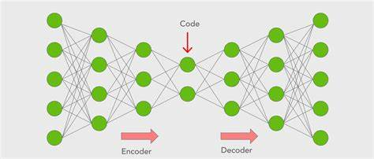
HOW DOES AN AUTOENCODER DENOISE IMAGES?
Consists of an Encoder and a Decoder
Encoder consists of convolutional layers that extract data and compresses image into the latent vector space
Decoder takes data from latent vector space and transforms it back into an image
Smaller Latent Space means autoencoder is forced to “learn” about meaningful features in data and ignore noise

Slide 4
PRELIMINARY RESULTS
Size of latent space is a trade-off. Smaller latent space means that the autoencoder is forced to ignore more noise, but also makes it miss features, resulting in blurriness.
Experiments carried out with 0-2 Max Pooling layers
Original size was 128 x 128, so latent vector space size ranges from 32 x 32 to 128 x 128
Binary Crossentropy Loss Function used with no regularization

Slide 5
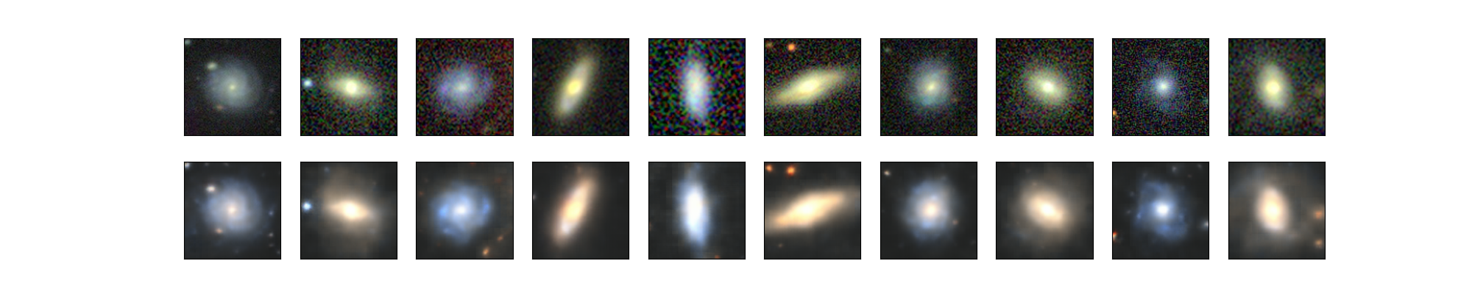
TWO MAX POOLING LAYERS

Slide 6
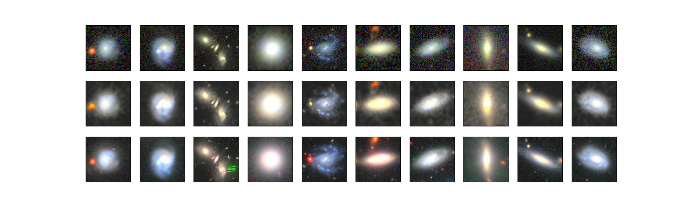
ONE MAX POOLING LAYER

Slide 7
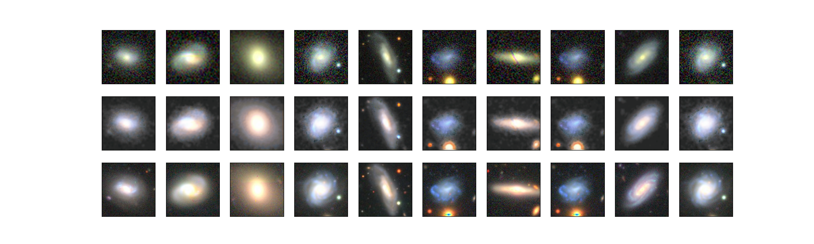
NO MAX POOLING LAYERS

Slide 8
PRELIMINARY CONCLUSIONS
Very clear trade off between noise reduction and blurriness.
Loss Function plateaus very quickly at ~0.52 (within 3-5 epochs) regardless of number of MaxPooling layers, so longer runs do not yield much improvement
Lower learning rate does not change plateauing of loss function
Seem to have a vanishing gradient- algorithm is learning all it can about data very quickly
Can we improve our basic algorithm? Yes!

Slide 9
INTRODUCING SKIP CONNECTIONS
Connections that “skip” layers in the encoder and decoder
Used to map earlier higher dimensional spaces to later feature spaces
Use earlier spaces to retain sharpness and later spaces to remove noise providing best of both worlds

Slide 10
A DIFFERENT LOSS FUNCTION
Binary Crossentropy works but only provides information on a per-pixel basis
Introduce the perceptual loss function- used to provide detail about image on a high level basis
Loss function used is a combination of the two- has a component of perceptual loss taken from VGG16 autoencoder, and a per-pixel loss, for which we use MSE

Slide 11
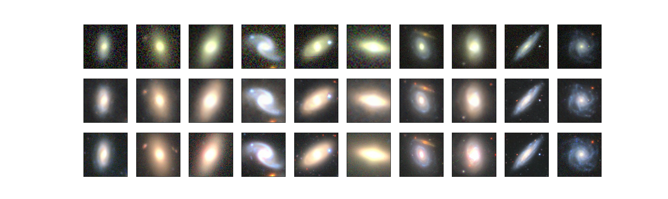
IMAGES AFTER 200 EPOCHS

Slide 12
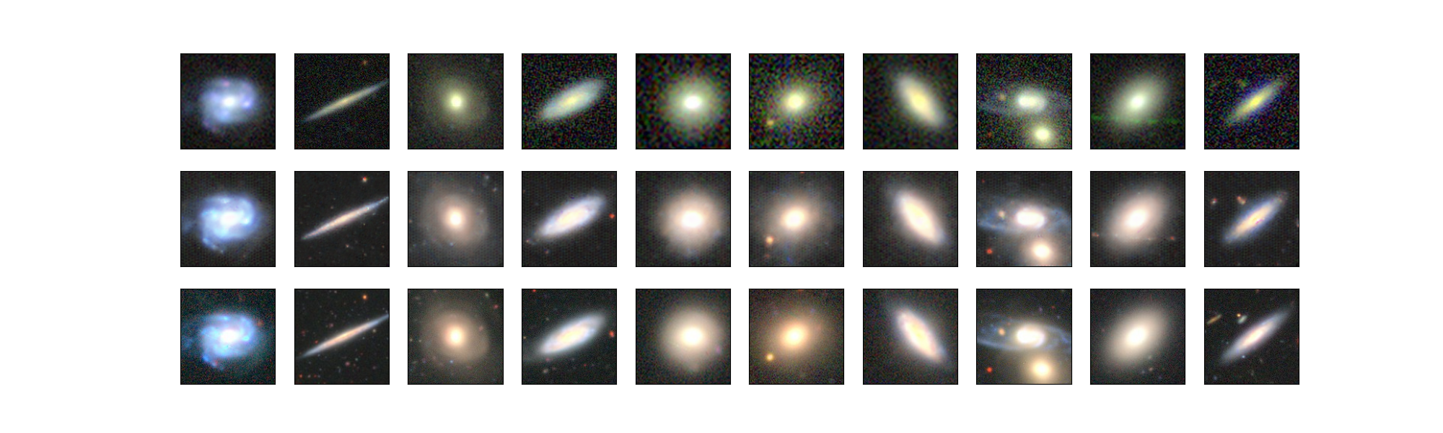
IMAGES AFTER 400 EPOCHS

Slide 13
CONCLUSIONS
Traditional Autoencoders work but have drawbacks
Must be shallow due to lossy compression causing inevitable loss of detail
Skip connections allow for much deeper autoencoders and help “solve” the blurriness issues
Change of loss function, and use of skip connections helps solve vanishing gradient problem (change in loss noted at 100 epochs too)
Network size increased dramatically (~5 million parameters from <= 1 million parameters) means that each epoch took 3-4 mins, but loss function still behaved in predictable manner and better results achieved in far fewer epochs anyways
Unfortunate checkerboard pattern still noticeable in background, but images are very close to HSC images

Slide 14
FURTHER WORKS
Impact of regularization: Superficial tests with regularization yielded subpar results, but final model used regularization and worked very well
Deeper network: Using a deeper network should be possible now that blurriness is solved, but should use more data for this purpose

Slide 15
ACKNOWLEDGEMENTS
Prof Kravstov for solving doubts, providing material, and providing me with computing power
Code that suggested using Skip Connections and Different Loss Function:Image Super Resolution and Denoising Using Autoencoder | by Ishih | Medium
TowardsDataScience article that explains skip connections very well: Using Skip Connections To Enhance Denoising Autoencoder Algorithms | by Metika Sikka | Towards Data Science
Paper that provides empirical data about skip connections being useful:2105.00695v1.pdf (arxiv.org)
Paper that proposes perceptual loss over ELBO (standard autoencoder loss function): https://arxiv.org/abs/1603.08155
Article that explains perceptual loss function in a simpler manner: Perceptual Loss Functions Definition | DeepAI

